Slide 1
Tableau For Data Analytics
Zero to hero by Namaste SQL

Slide 2
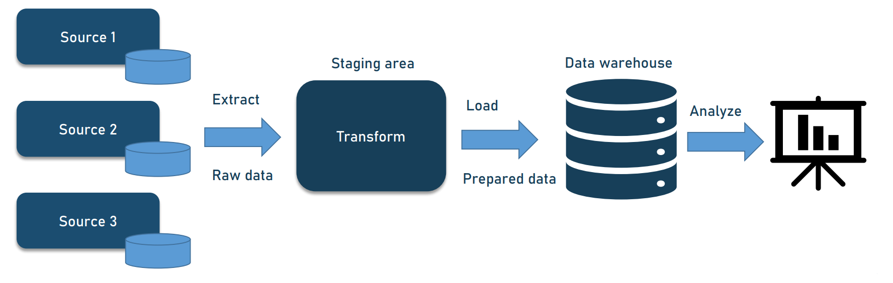
Data Analytics -> The Big Picture
Data Visualization
Excel, Tableau
,Power BI ,Qlik etc

Slide 3
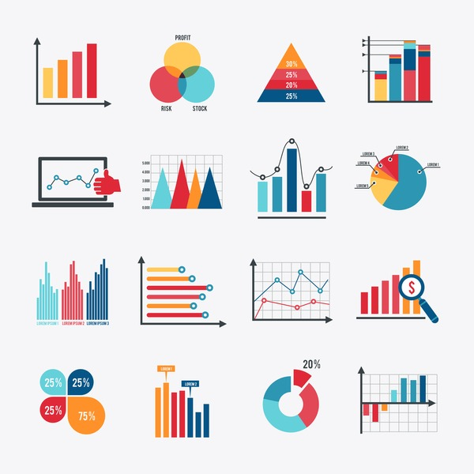
What is data visualization
Data visualization is the process of representing data and information graphically through charts, graphs, maps, and other visual tools.

Slide 4
Why it is required
Simplifies Complex Data
Finding solution to problems
Identify trends , patterns and relationships, comparative analysis
Fast decision making
Highlights Important Information
Improves Retention and Recall

Slide 5
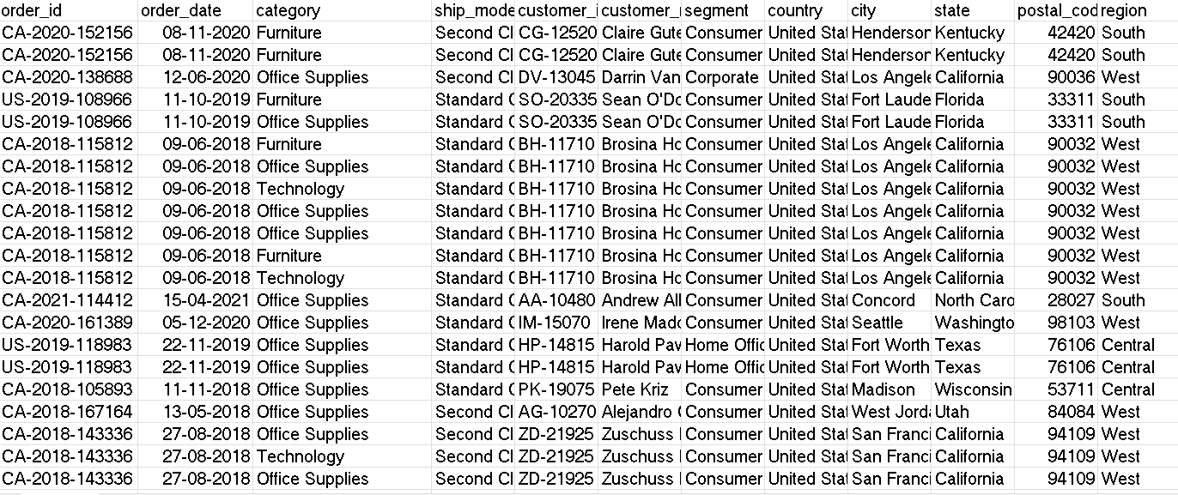
Data in raw form

Slide 6
Data in the form of charts

Slide 7
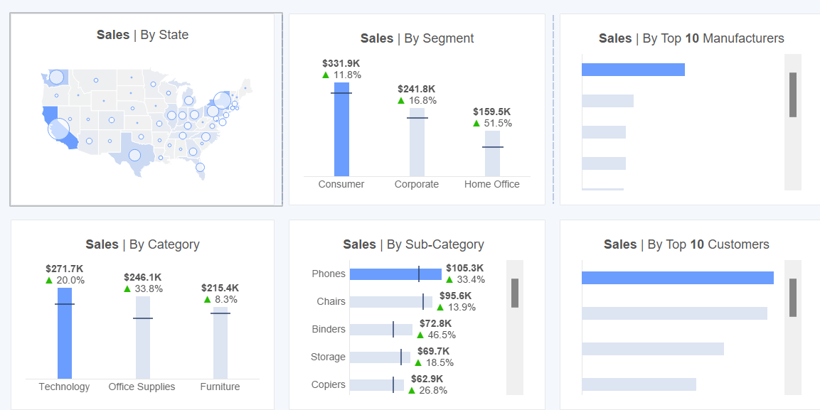
Orders data dashboard

Slide 8
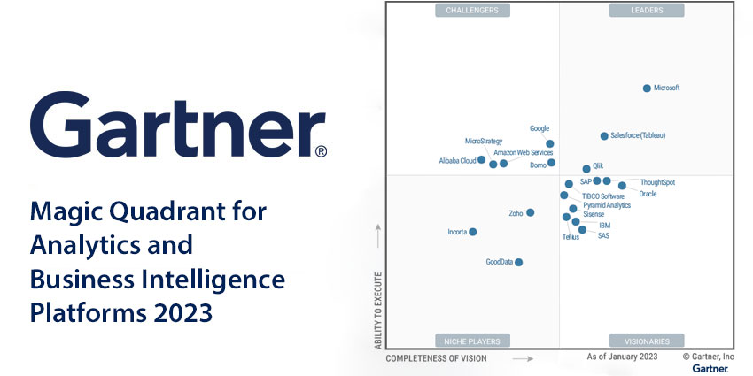
Gartner Report

Slide 9
What is Tableau?
Tableau is a powerful data visualization tool used for converting raw data into an understandable format through interactive and shareable dashboards.
It provides a wide range of visualization options to create charts, graphs, maps, and other visual representations of data.
Tableau is known for its user-friendly interface, allowing users to quickly and easily connect to various data sources, perform data analysis, and share insights.
It is widely used in business intelligence to help organizations make data-driven decisions.

Slide 10
Tableau Ecosystem
Tableau offers a variety of products tailored to different needs and use cases in data visualization and business intelligence. Here are the main product offerings from Tableau
Tableau Desktop Public
Tableau Desktop Professional
Tableau Server
Tableau Online
Tableau Reader
Tableau Prep

Slide 11
Download and install Tableau Desktop
Tableau Desktop Public: https://www.tableau.com/products/public/download
Tableau Desktop Professional : https://www.tableau.com/products/desktop/download
Tableau Public: https://public.tableau.com/app/discover

Slide 12
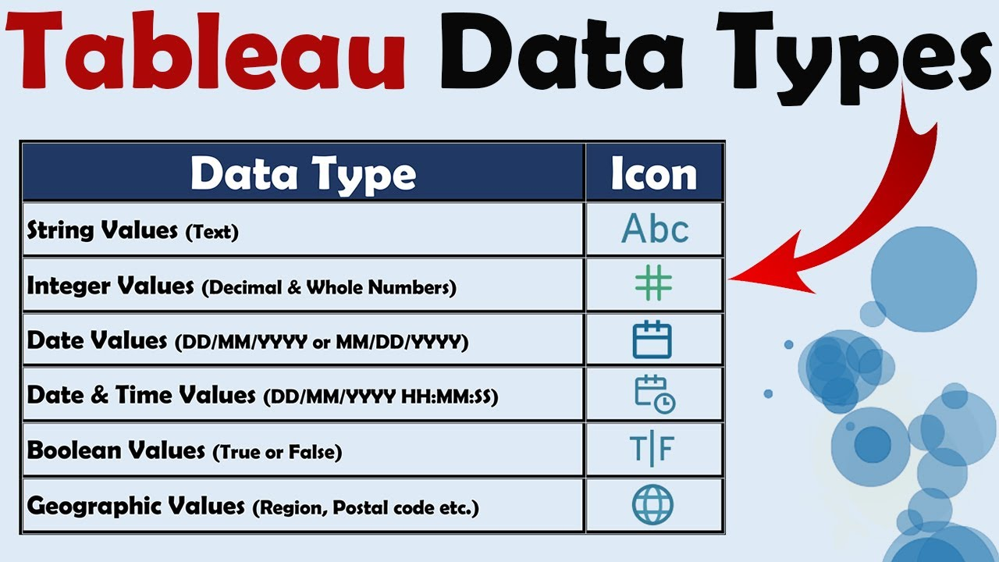
Data Types in Tableau

Slide 13
Dimensions
Dimensions are qualitative fields that typically contain categorical data. They describe the "what," "who," "where," and "when" of your data. Dimensions are used to segment and categorize data, and they often form the rows and columns of your data table. They help in slicing and dicing your data to drill down into specific details.
Examples of dimensions include:
Names (e.g., customer names, product names)
Dates (e.g., order dates, birthdates)
Geographic locations (e.g., countries, cities)
Categories (e.g., product categories, departments)
In Tableau:
Dimensions are displayed in blue in the data pane.
They are used to create headers, labels, and axes in charts.
They are usually discrete (distinct, separate values).

Slide 14
Measures
Measures are quantitative fields that typically contain numerical data. They represent the metrics or quantities that you want to analyze. Measures are used to perform calculations, aggregate data, and provide the values you want to analyze and visualize.
Examples of measures include:
Sales revenue
Profit
Quantity sold
Scores or ratings
In Tableau:
Measures are displayed in green in the data pane.
They are used to create axes and determine the size, length, or position of marks in charts.
They are usually continuous (can take any value within a range) and can be aggregated (e.g., sum, average, count).

Slide 15
Discrete vs continues fields in Tableau
Discrete fields are categorical and contain distinct, separate values. They represent things that can be counted in distinct units and are often used to segment and categorize data. Discrete fields are typically used for creating headers/labels. Discrete fields are represented in blue.
Continuous fields are quantitative and represent measurable quantities that can take any value within a range. They are typically used for axes that show a range of values, such as time series, measures, and numerical ranges. Continuous fields are represented in green.

Slide 16
Live vs Extract Connection
Live connection means that Tableau directly queries the data source in real time whenever you create or interact with a visualization. This ensures that you are always working with the most current data.
Real-Time Data: Always provides the most up-to-date data.
No Storage Required: Data is not stored locally, reducing storage requirements on your machine.
Dynamic Updates: Any changes in the data source are immediately reflected in Tableau.
Extract involves creating a snapshot of the data at a specific point in time and storing it in Tableau’s proprietary format (.hyper or .tde file). The data is imported into Tableau, and all operations are performed on this static copy.
Improved Performance: Extracts are optimized for fast querying, often resulting in better performance, especially with large datasets.
Offline Access: Extracts can be used offline without needing constant access to the original data source.
Reduced Load on Data Source: Since the data is extracted, it reduces the load on the original data source.

Slide 17
File Types in Tableau
Tableau Workbook (.twb): This file contains the definitions of the data sources, worksheets, dashboards, and stories but does not contain the actual data. It's a lightweight file that saves references to the data.
Tableau Packaged Workbook (.twbx): This is a packaged version of a .twb file that includes the workbook along with any data sources and images used. It’s useful for sharing workbooks with others who may not have access to the original data sources.
Tableau Data Extract (.hyper and .tde): These files contain a snapshot of your data optimized for fast query performance in Tableau. .hyper is the newer format, replacing .tde.

Slide 18
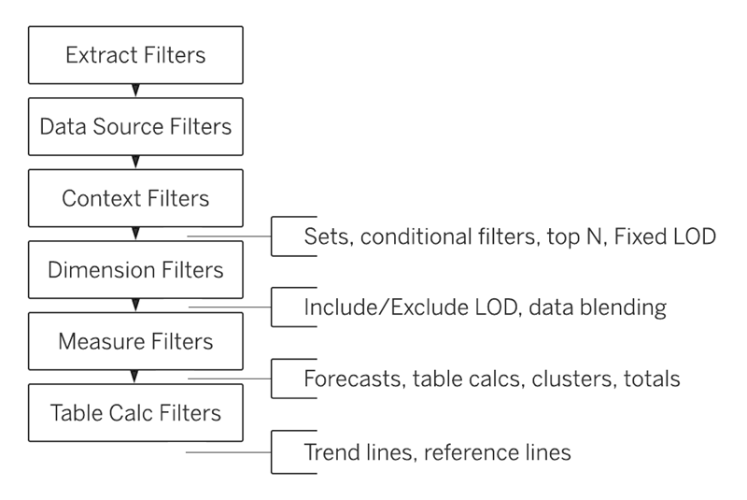
Tableau Order of Operations

Slide 19
Tableau fundamentals
Filters dimension/measures
Bar chart / line chart -> formatting
Marks types
Data Granularity In Tableau
Working with dates
Measure name / measure values
Calculated columns-> dimensions/measures/aggregated measures
Dashboard overview and save to tableau public

Slide 20
Chart Types
Tables/cross tab
Bar / stacked bar/ side by side bar
Line / area charts
Pie chart
Dual axis chart
Combined axis chart
Highlight table
Histogram
Scatter plot

Slide 21
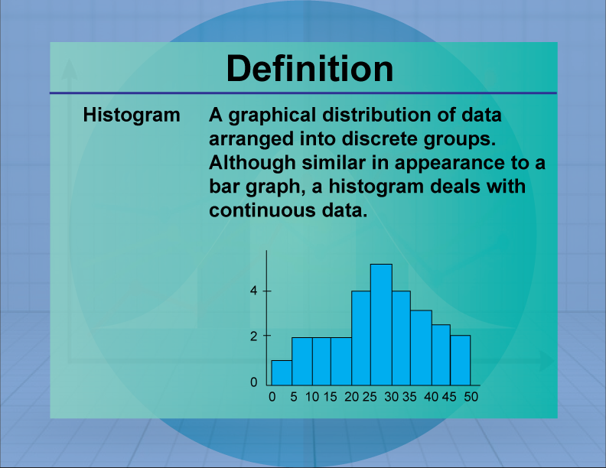

Slide 22
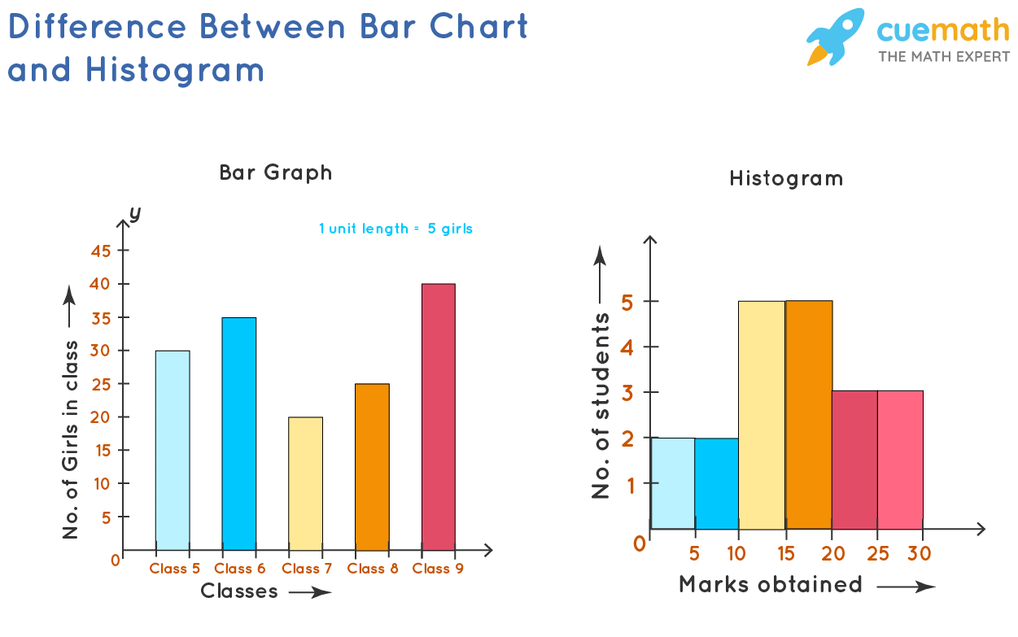

Slide 23
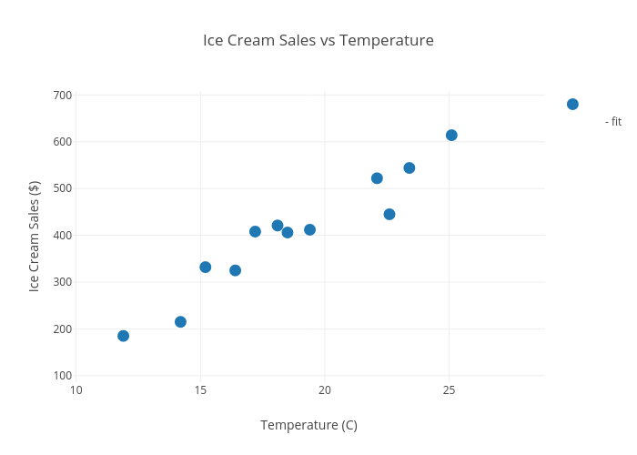
Scatter Plots
A scatter plot (aka scatter chart, scatter graph) uses dots to represent values for two different numeric variables. The position of each dot on the horizontal and vertical axis indicates values for an individual data point. Scatter plots are used to observe relationships between variables.

Slide 24
Calculated fields
1- Row level calculations
2- Aggregated calculations
3- LOD
4- Quick table calculations
Row level:
String -> split , contains , concat
dates -> datediff
Logical -> if else
boolean

Slide 25
Parameters 1- Top N /Index 2- Stacked bar chart(sc / region) 3- calculations -> choose dimension

Slide 26
Groups
A tableau group is a set of multiple members combined in a single dimension to create a higher category of dimension.
From chart labels / marks
From dimension directly
Using find option -> product name
Groups are static

Slide 27
Sets
Sets in Tableau are used to create subsets of data based on certain conditions defined by the user. For example, a set can be created for having a subset data of top 10 customers with the highest sales.
Fixed sets
Dynamic sets
Combined sets
Combined sets
Top 10 and bottom 10 by profit -> union
Top 10 by sales and bottom 10 by profit -> intersect

Slide 28
Hierarchy and drill down

Slide 29
Maps
filled maps
Symbol maps
Custom territory
Dual axis
Create role (region)
Postal code -> give geo role
Custom geo coding
Unrecognize, ambiguous , manual latitude ,longitude

Slide 30
Table calculations
Table calculations are transformations you can apply to the aggregated values in a visualization. They are a special type of calculated field that computes on the local data in Tableau based on what is currently in the view.
Table calculations are impacted by
Layout
Direction (addressing)
Scope (partitioning)
Filters
Table calculations rely on two types of fields: addressing and partitioning fields. The key to understanding table calcs is to know how these fields work.
Partitioning fields define the scope: They break up the view into multiple partitions or sub-views. The table calculation is then applied to the marks within each partition.
Addressing fields define the direction: They define the “direction” that the calculation moves (for example, in calculating a running sum, or computing the difference between values).

Slide 31
Quick table calculations
Additional table calculations -> index, rank , running sum etc

Slide 32
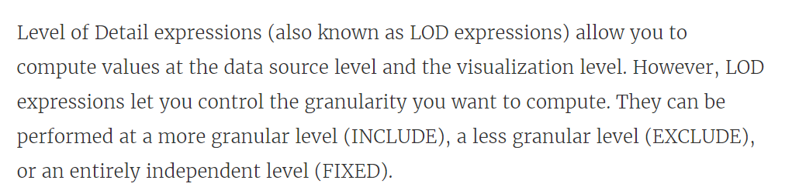
LOD Expressions

Slide 33
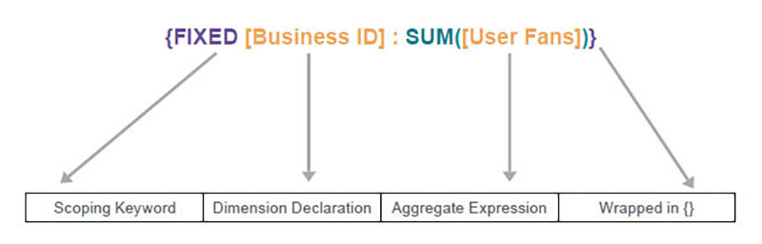
Types of LOD
Fixed : Independent of the view
Include: Add to view
Exclude : minus from view
Syntax :

Slide 34
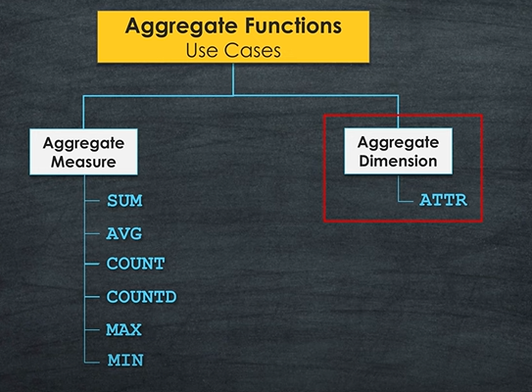
ATTR (Attribute)
ATTR() is a special Tableau function that effectively returns a record-level result as an aggregation. If there are multiple values of the record-level field in the current context then ATTR() will return * instead of a single value.

Slide 35
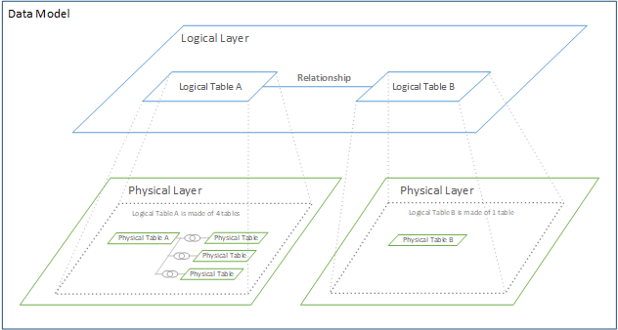
Data Model in Tableau

Slide 36
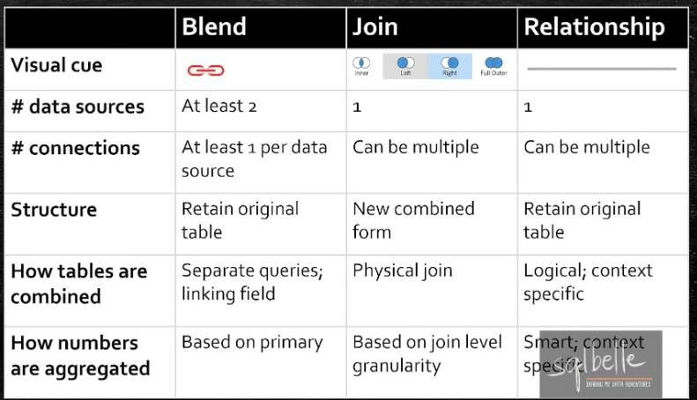
relationship -> joins-> blending

Slide 37
Union, pivot unpivot

Slide 38
Add a Slide Title - 5

